Slide 1
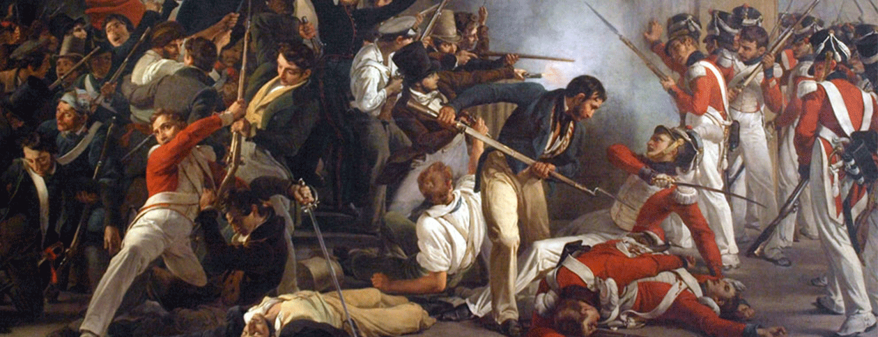
Conflict Theory

Slide 2
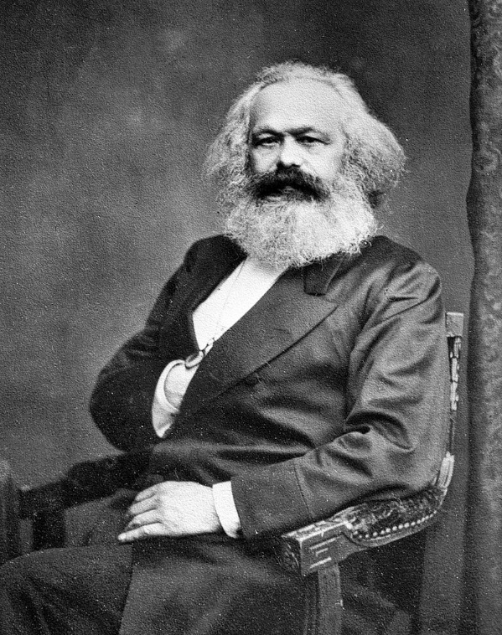
Conflict Theory
Karl Marx
German philosopher and economist
Father of conflict theory
Marxism
Theories of Karl Marx (and Friedrich Engels)
Society developed through four stages
Primitive Communism
Ancient Society
Feudal Society
Capitalist Society
All of human history is a result of conflict between different classes

Slide 3
Marx
“The history of all hitherto existing society is the history of class struggles. Freeman and slave, patrician and plebeian, lord and serf, guild-master and journeyman, in a word, oppressor and oppressed, stood in constant opposition to one another, carried on an uninterrupted, now hidden, now open fight, a fight that each time ended, either in a revolutionary re-constitution of society at large, or in the common ruin of the contending classes.”

Slide 4
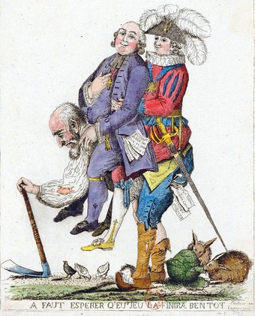
Conflict Theory
Individuals and groups interact on the basis of conflict, not consensus
As a result of conflict different groups will have different levels of material and non-material resources
More powerful groups will use their power and wealth to exploit the poor and powerless

Slide 5
Basic Ideas
Inequality in society produces conflict, not order and consensus
Must result in a change of relations
The disadvantaged (poor & powerless) have interests against the status quo
are agents of change
Their potential is limited by exploitation and oppression
The state serves the interests of the elite, not everyone
Institutions help maintain the status quo
There is no consensus (no cultural, religious, or legal agreement)
The elite force their ideas on the less powerful
Their ideology serves their interests

Slide 6
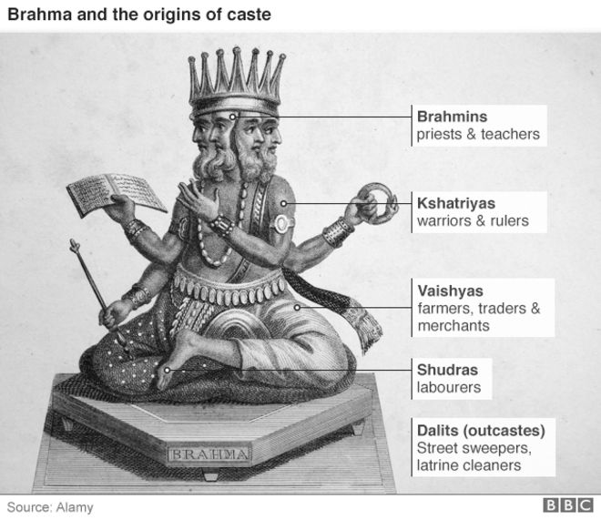
Example: Hindu Caste System
Inequality
Power and wealth concentrated in higher castes
Lower castes exploited
Cannot fulfill potential
No Consensus
Social structure and state serve the interests of the elite
Change in relations
Lower classes have interests against the status quo

Slide 7
Vocabulary
Conflict – a serious disagreement (usually a long one)
Inequality – lack of equality (not equal)
Consensus – general agreement (everyone agrees)
Status Quo – the way things are now
Exploitation – unfair treatment in order to benefit from their work
Oppression – long term cruel or unjust treatment

Slide 8
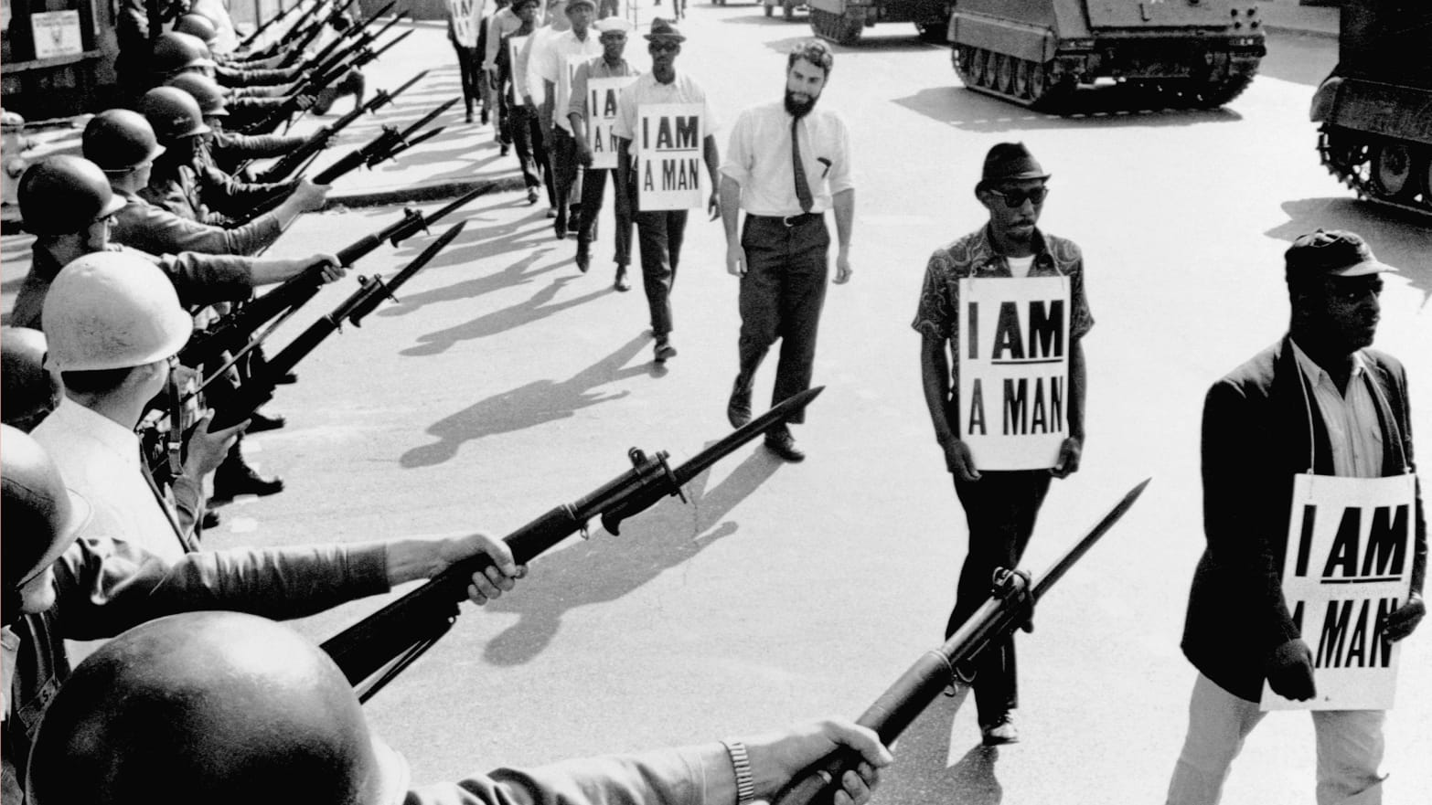
Case Study: Race in the South (USA)
History:
African slaves in the southern states of the USA freed during Civil War (1861-1865)
Had been brutally exploited by white slaveholders (cotton, tobacco, other crops)
Political, Civil, Economic, Social equality denied them after the war
Inequality
Power and wealth controlled by whites
Exploitation
Black labor exploited by whites
Oppression
Violence against blacks
Potential Limited

Slide 9
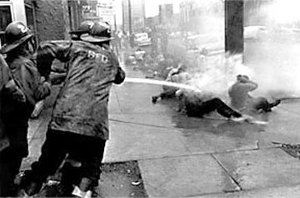
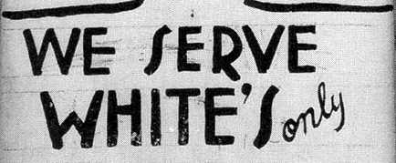
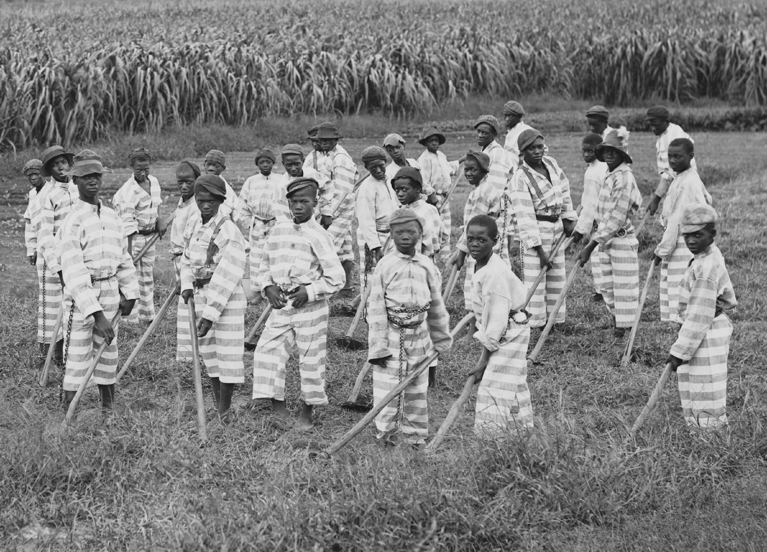
Institutions and White Power
State
Black voters suppressed
Literacy tests, poll taxes
Government dominated by whites
Law
Jim Crow laws
Racial segregation
Biased legal system
All-white juries
Police
Tool of oppression
Lynching

Slide 10
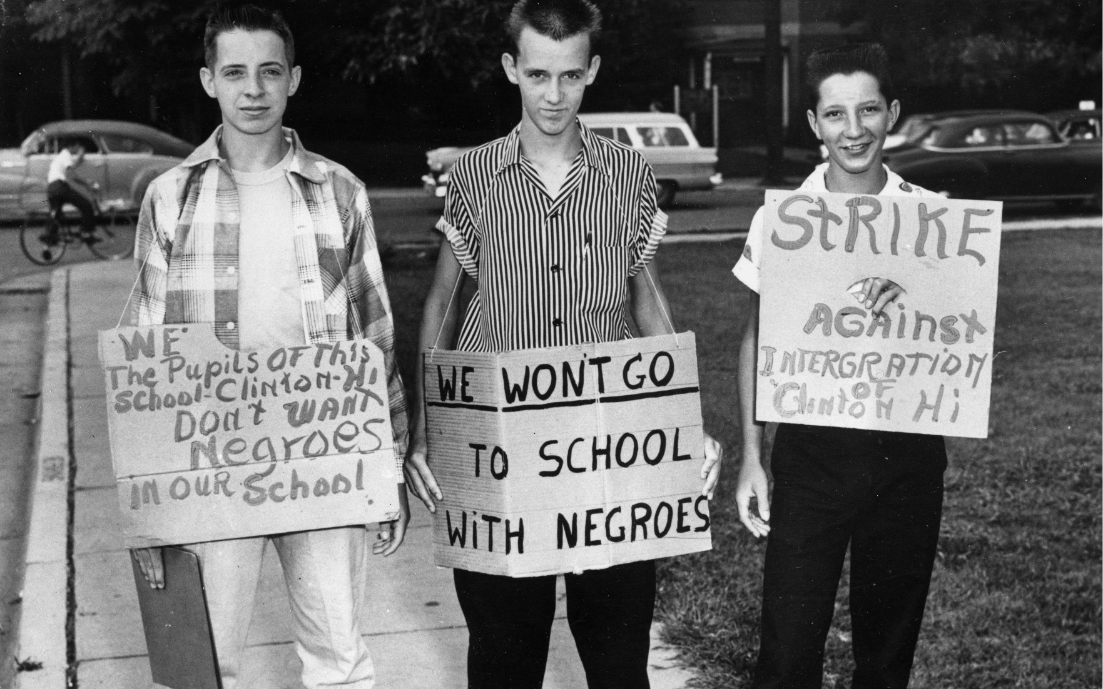
Culture
Socialization
Norms
Customs
Traditions
White racism
Taught to be racist
Black underclass
Told not expect better

Slide 11
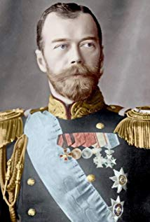
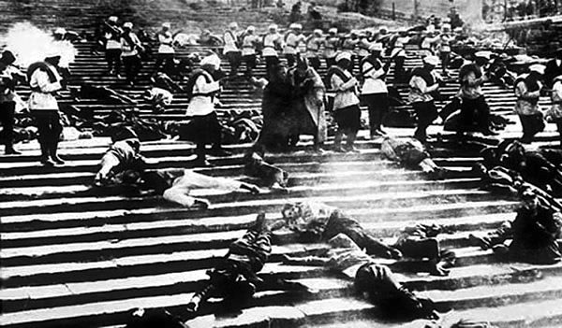
Tsarist Russia
Tsar Nicholas II
Autocrat (all power)
Conservative (against change), backwards
Peasant Conditions
Serfs emancipated 1861
No land, pay to farm land
Worker Conditions
10+ hour days, 6 days/week
Low wages, dangerous work
Oppression
Tsar’s police shoot protestors

Slide 12
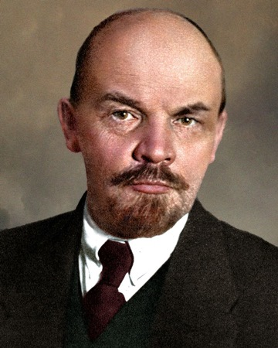
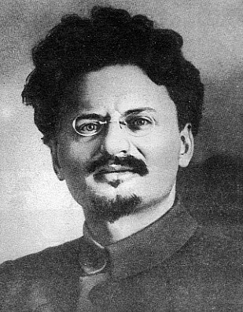
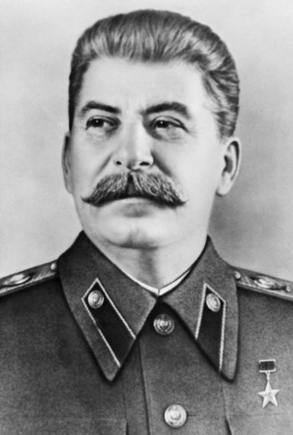
1917 – The Russian Revolution
Feb 1917 – Tsar overthrown
Oct 1917 – Bolsheviks take power
Led by
Vladimir I. Lenin
Leon Trotsky
Joseph Stalin
Communism
Means of production owned by the community
Egalitarian – no class, no money, no state
In Russia: Dictatorship of the Proletariat

Slide 13
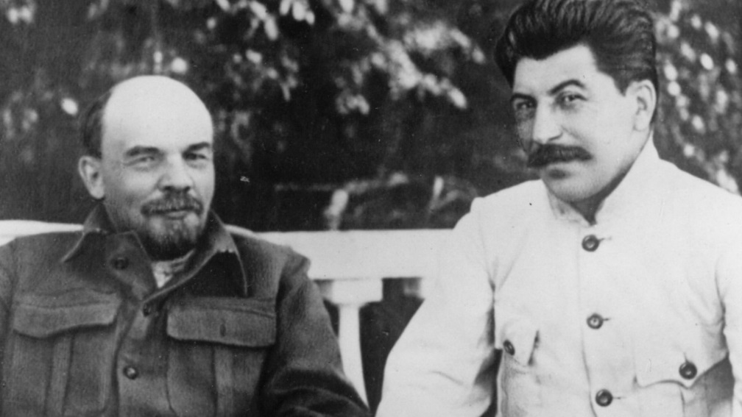
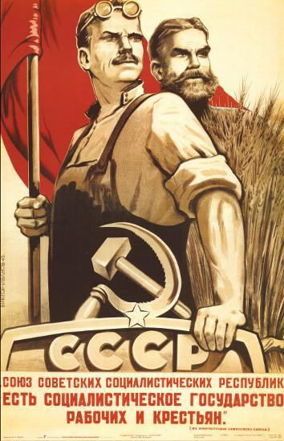
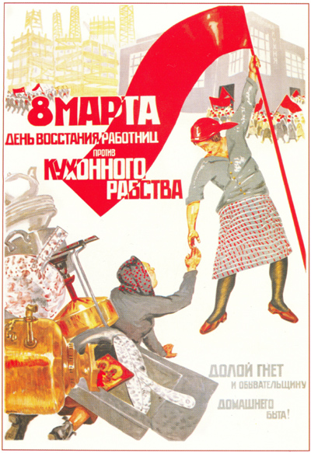
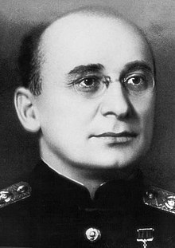
Russia After the Revolution
Communism
Dictatorship of the Proletariat (workers)
Collectivization
Industrialization
Stalin
Succeeds Lenin after his death in 1924
Great Terror
Oppression
Trotsky murdered in Exile
Show Trials
Censorship
Gulags

Slide 14
Animal Farm

